Slide 1
Pantry Pal
Date: 7/24/2023
Team: Raghavendra Raikar, Hisham Hoque, Aaron Wu, Zhengheng Li, Sayak Datta, Yernar Smagulov

Slide 2
Introduction to problem and domain
Problem: Many people, constrained by limited time, budget, and cooking skills, struggle to consistently prepare healthy meals, leading to a reliance on fast food or packaged meals that can negatively impact their health; there is a need for a tool that can take available ingredients and efficiently recommend simple, healthy recipes that can be easily prepared.
Motivation: With a passion to help people eat healthier and make the most of their available ingredients, we want to build a recipe recommendation API that can suggest a variety of delicious and nutritious meals by using a ML model

Slide 3
Goals
To develop an efficient web scraping system that can gather recipes from multiple websites and build a complete database(DONE)
To develop and implement a robust recipe recommendation system using ML capable of suggesting recipes based on user-inputted ingredients (DONE)
To create an intuitive and user-friendly front-end interface using Streamlit, allowing users to easily input their available ingredients and view recommended recipes. (DONE)
To incorporate a variety of recipes, including those that cater to different dietary restrictions and preferences(DONE)
To deliver a functional API that can be integrated with other applications or services, extending the reach and usefulness of the recipe recommendation tool(DONE)
To promote healthier eating habits among students by providing easy access to a variety of recipes they can make with their available ingredients(DONE)

Slide 4

Demo video

Slide 5
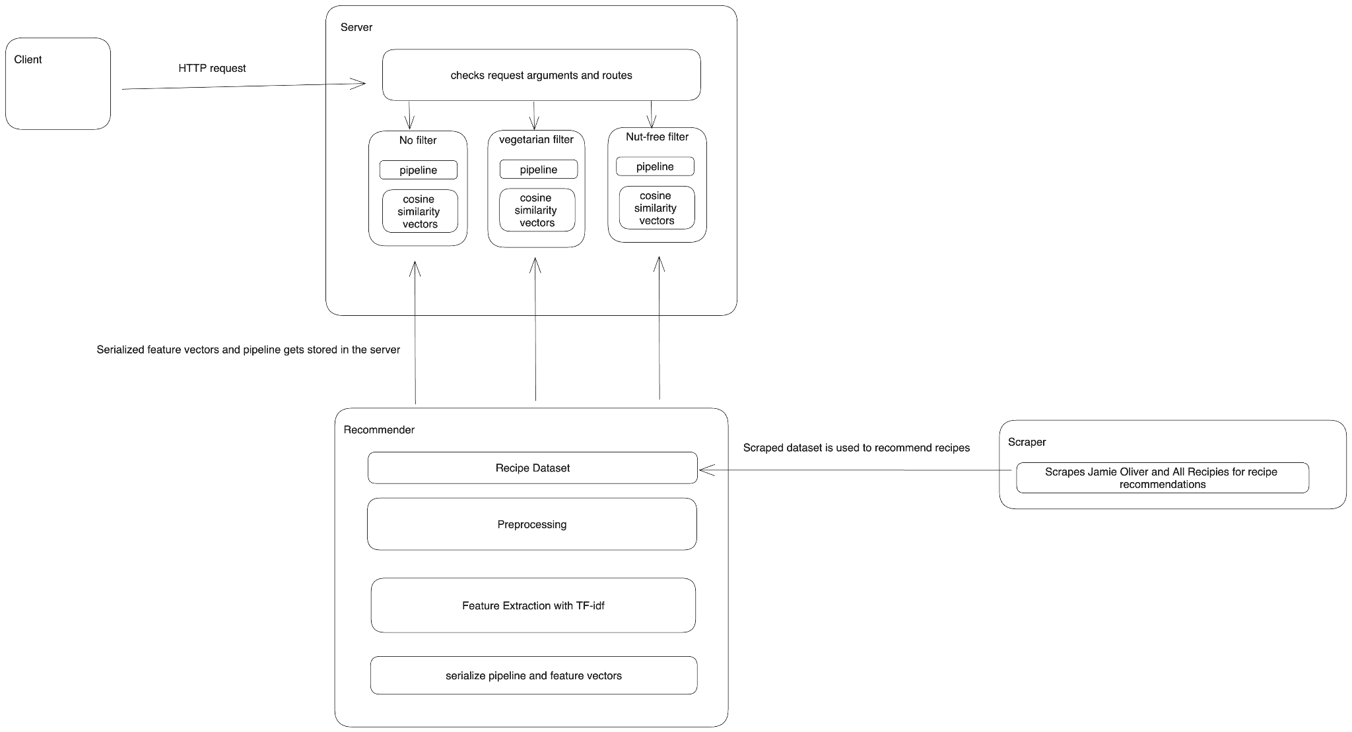
System Diagram

Slide 6






Technologies

Slide 7
Product Management techniques
Discord Server - daily communication/updates
3 Scrum meetings a week - via Discord
Jira - Scrum board, backlogs

Slide 8
Challenges in Development
New technologies/tools
First time working on a large software in a development team
Communication - are we on the same page?
Scheduling - no time conflict?
ML model: how do we preprocess the ingredients?
“1 (8 ounce) package sliced mushrooms, or to taste (optional)” ⟹ “mushroom”

Slide 9
Things we enjoyed/didn’t enjoy
Enjoyed:
Working as a team
Meeting up together/conducting meetings
Watching idea come to life
Didn’t Enjoy
Debugging issues
Short time frame

Slide 10
Lessons Learned
What worked:
Daily Scrum standups
Sprint Retrospectives
Sprint planning
What didn’t work:
Following scrum practices in very first sprint(took time to adjust)
Things we wished we did:
More unit testing
Following Agile practices is effective in the long run
Makes easier to develop a fully finished product
Learned to be more organized/work effectively in group projects

Slide 11
Q&A

